Slide 1
GRADUATE ADMISSION PREDICTION USING ML
CS5710 MACHINE LEARNING (CRN: 30521)

Slide 2
Team details & Contributions
Vani Atmakur, 700747639
Nithisha Gundeti, 700743012
-Worked on dataset, data preprocessing and applied logistic regression on the dataset and documentation
-Worked on dataset, data visualization and applied random forest and support vector machine logistic on the dataset

Slide 3
ABSTRACT
In the current tutoring world there are various amounts of students who need to pursue higher preparation following Engineering or any Graduate confirmation course. High level training in the sense, a couple bunches need to do MTech through GATE or through any Instructive Institute Entrance Examination and a couple bunches need to do MBA through CAT or through any individual Educational Institute Entrance Examination such as GRE, TOEFL and a couple of gatherings need to do Masters in abroad schools. Student affirmation issue is indispensable in Educational Organizations. We are addressing AI models to expect the chance of a student to be surrendered to a Master’s program. This will assist students with knowing early if they get an amazing chance to get recognized. The Machine it is Linear to learn models backslide, Decision tree regressor and Random Forest regressor. Examinations show that the Linear Regression model outflanks various models

Slide 4
Motivation
01
To enhance the process of undergraduates admission into the grad schools more transparent using the latest tech trends
02
To apply the machine learning techniques on the very needed process flow to meet the needs of the graduate schools while admitting the or granting admissions into the applicants

Slide 5
Objectives
01
To apply the data preprocessing techniques to clean the real world streamed data and enhance the model results after applying the machine learning techniques.
02
Evaluating the performance of each machine learning model with the considered dataset.

Slide 6
Related Work
01
GRADE framework was created by Waters and Miikkulainen (2013) to help the affirmation cycle for the graduate understudies in the University of Texas Austin Division of Computer Science[4].
02
The fundamental target of the assignment was to develop a construction that can assist the declaration with boarding of the school to take better and quicker choices[12].
03
Bibodi Et al. (n.d.)) [14] utilized different AI models to make a framework that would assist the understudies with shortlisting the colleges reasonable for them likewise a subsequent model was made to assist the schools with settling on enrolment of the understudy[7].
04
Impediment of this exploration as that it did just depend on the GRE, TOEFL and Undergraduate Score of the understudy and missed on thinking about other significant variables like SOP furthermore, LOR archives quality, past work insight, specialized papers of the understudies and so forth[10]

Slide 7
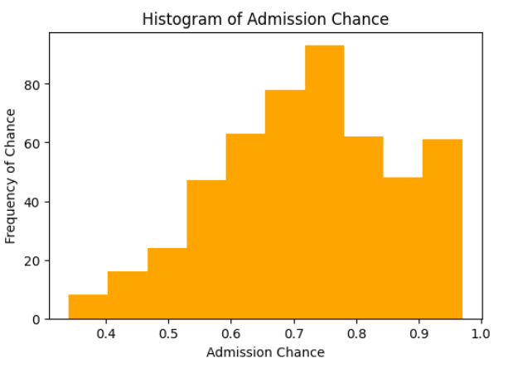
Proposed Methodology
Firstly we accessed the graduate admission prediction dataset from the below source: https://www.kaggle.com/datasets/mohansacharya/graduate-admissions
Applied data preprocessing techniques on the dataset to clean the real time data such as filling the missing data and getting rid of the outliers
Now, the features in the dataset are visualized using the matlplotlib and seaborn modules in python.

Slide 8
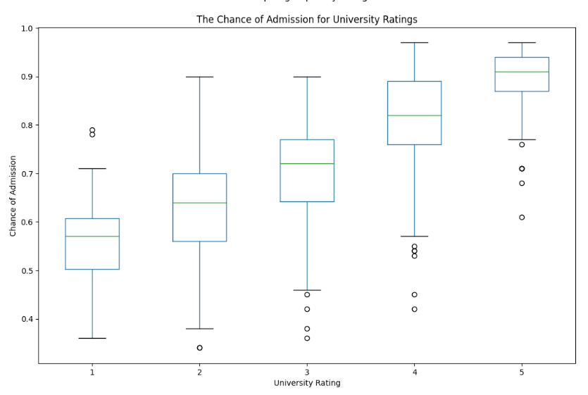
Continued..
Now, the plot between the university rating and also the chances of admission into that particular university is visualized using the boxplot.
Finally the correlation coefficient matrix is plotted to pull out the most influencing features oin the target variable to be used for the model training.

Slide 9
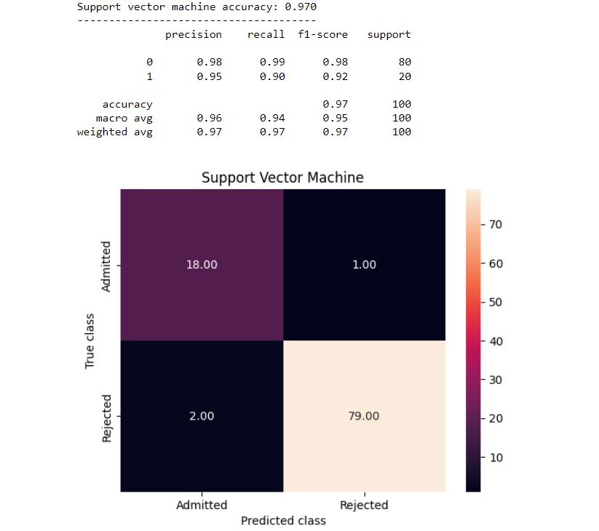
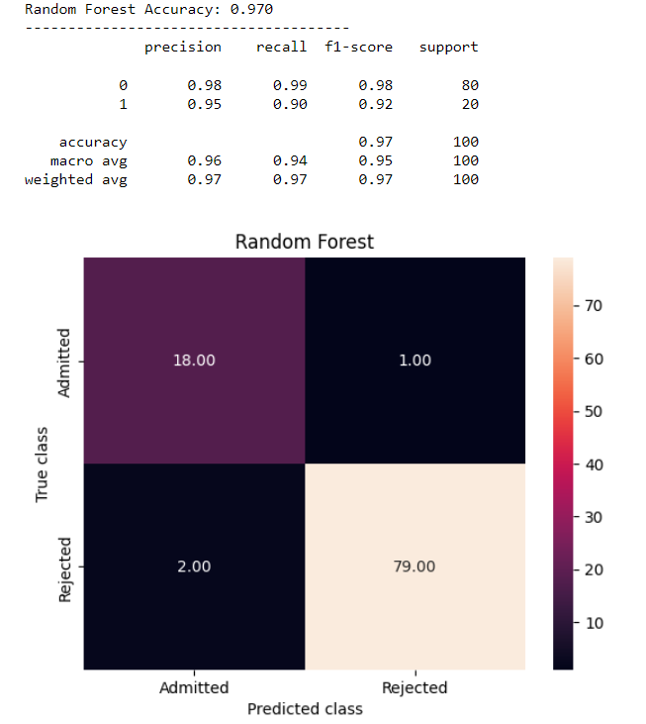
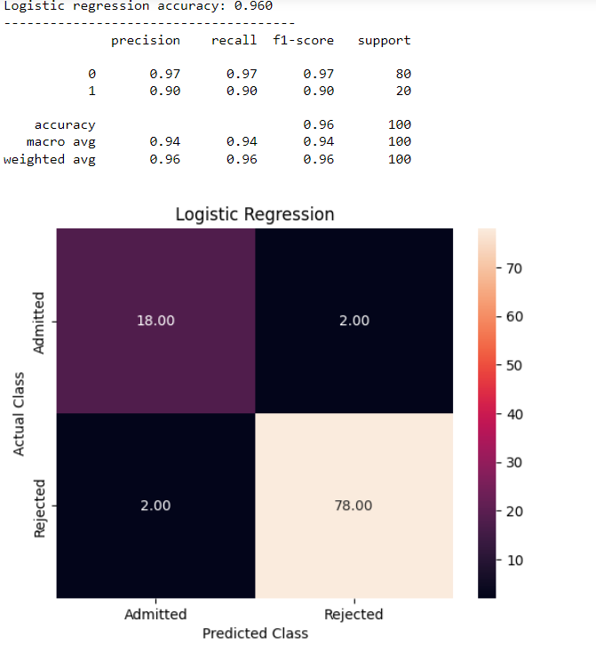
Results
Finally we selected the 3 supervised machine learning algorithms i.e. Logistic regression, Random forest and Support vector machine to train our graduate admission prediction dataset. And the results of each algorithm is presented below with the classification report and the confusion matrix.

Slide 10
Conclusion
Understudy confirmation issue is vital in instructive establishments. In this undertaking tends to AI models to foresee the opportunity of an understudy to be conceded. This will assist students with staying alert somewhat early expecting they get a potential chance to get recognized. Tests show that the Linear Regression model outperforms different models. Our point is predicting the ”Chance of Admit” considering the different limits that are given in the dataset. We will accomplish this point by utilizing the Linear Regression model. In light of the information that we have, we will part out information into preparing and testing sets. The Training set will have features and checks on which our model would be ready.When our model is prepared, we will utilize the prepared model and run it on the test set and foresee the result. Then, we will differentiate the expected results and the veritable results that we want to see how our model performed. This entire course of preparing the model utilizing includes and known marks and later testing it to foresee the result is called Supervised learning.

Slide 11
References
[1] M. Injadat, A. Moubayed, A. B. Nassif, and A. Shami, “Multi-split Optimized Bagging Ensemble Model Selection for Multi-class Educational Data Mining,” Appl. Intell., vol. 50, pp. 4506–4528,
2020.
[2] F. Salo, M. Injadat, A. Moubayed, A. B. Nassif, and A. Essex, “Clustering Enabled Classification using Ensemble Feature Selection for Intrusion Detection,” in 2019 International Conference on Computing, Networking and Communications (ICNC), 2019, pp. 276–281.
[3] M. N. Injadat, A. Moubayed, A. B. Nassif, and A. Shami, “Systematic ensemble model selection approach for educational data mining,” Knowledge-Based Syst., vol. 200, p. 105992, Jul. 2020.
[4] A. Moubayed, M. Injadat, A. B. Nassif, H. Lutfiyya, and A. Shami, “E-Learning: Challenges and Research Opportunities Using Machine Learning Data Analytics,” IEEE Access, 2018.
[5] M. S. Acharya, A. Armaan, and A. S. Antony, “A Comparison of Regression Models for Prediction of Graduate Admissions”, Kaggle, 2018. .

